Slide 1
WiTrack
Localization and Tracking Using RF Waves

Slide 2
FYP report reviewed by the Advisor (Yes)
FYP report uploaded on PMS (Yes)
FYP demo reviewed by advisor (No)
FYP demo uploaded on PMS (Yes)
Course feedback of all courses submitted on cms (Yes)

Slide 3
Group Members
Saad Ur Rehman (BEE8D)
Muhammad Gul (BEE8B)
Abdur Rehman (BEE8B)
Advisor
Dr. Fahd Ahmad Khan

Slide 4
Problem Statement
High Range Resolution requires Larger Bandwidth
(FMCW Radar, Pulsed Radar, Noise Radar)
Expensive Hardware
Requires Large Bandwidth for short range detection
Can/Cannot exploit Doppler effect

Slide 5
Objective
A system in which Range Resolution is independant of Bandwidth
Digital Based
Least Hardwaare

Slide 6
Our Solution
Range Resolution is independant of Bandwidth
Range Resolution and accuracy rather depends on computational complexity
Does require Large bandwidth for short-range detection
Can be used to extract Doppel effect of moving objects
Can be used even in sub 1Ghz implementations

Slide 7
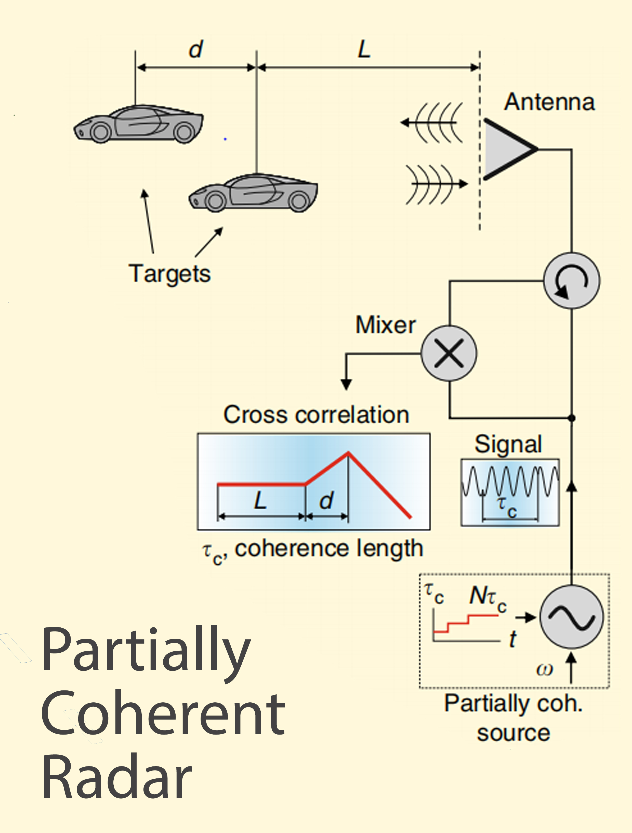
Schematic repResentation of the proposed system
A transmission signal of increasing coherence lengths is sent out, where each coherence length is composed of a specific number of phase jumps.
The received signal is mixed with still transmitting signal to obtain cross correlation of each coherence length.

Slide 8
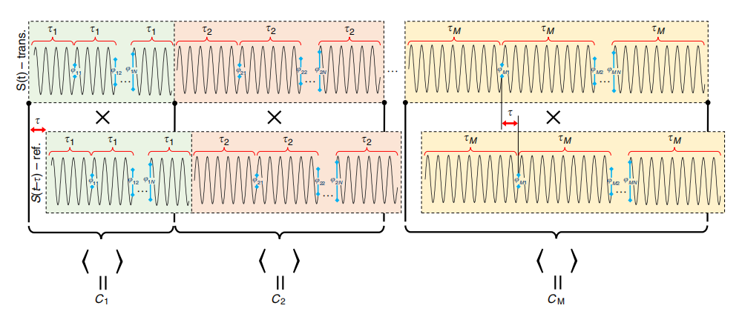
Tx (Transmission Signal)
For,
Coherence lengths, M = 300
Phase jumps, N = 16
Carrier Frequency, Fc = 6GHz
The transmission signal is displayed here,
where C₁ , C₂ ....... C_{M} are the cross correlation coefficients of mixing the transmiited and received signals

Slide 9
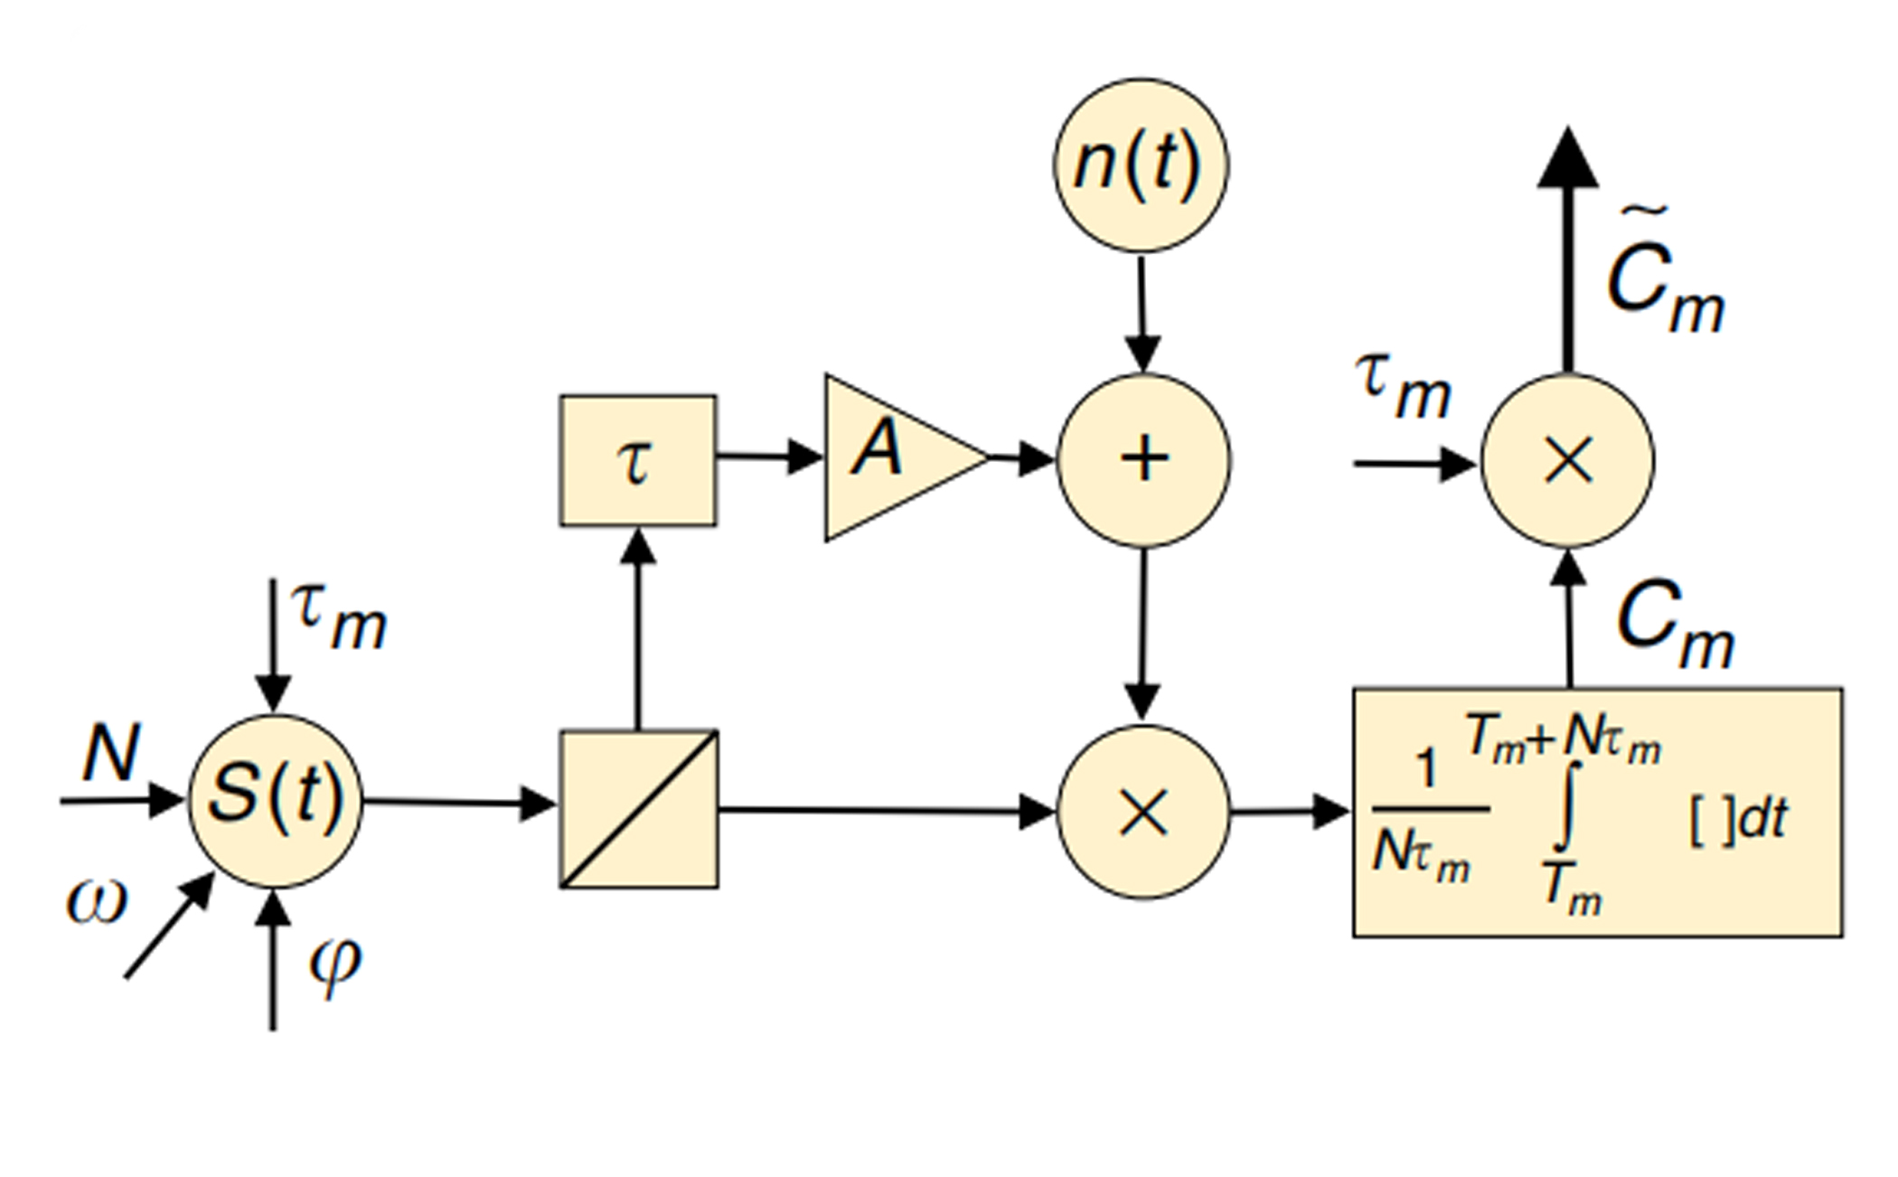
Block Diagram
N = phase jumps
M = coherence points
ω = frequency
θ = phase
s(t) = Tx
Ƭ_{m} = each coherence time
Ƭ = delay
A = attenuation
n(t) = random noise
☒ = mixer
Cm = cross correlation co-eff

Slide 10
Cross Correlation
By displaying cross correlation as function of distance, we get breakpoints at location of the targets.
As displayed here, two targets are present at 23.6 and 25.4 meters away from transmitter.

Slide 11
Matlab Simulation
using time parameters described in block diagram, we verified simulations for:
SST(Single Statationary Target)
MST(Multiple Stationary Target)
SMT(Single Moving Target)

Slide 12
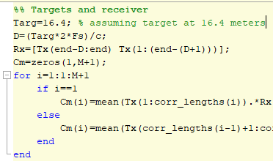
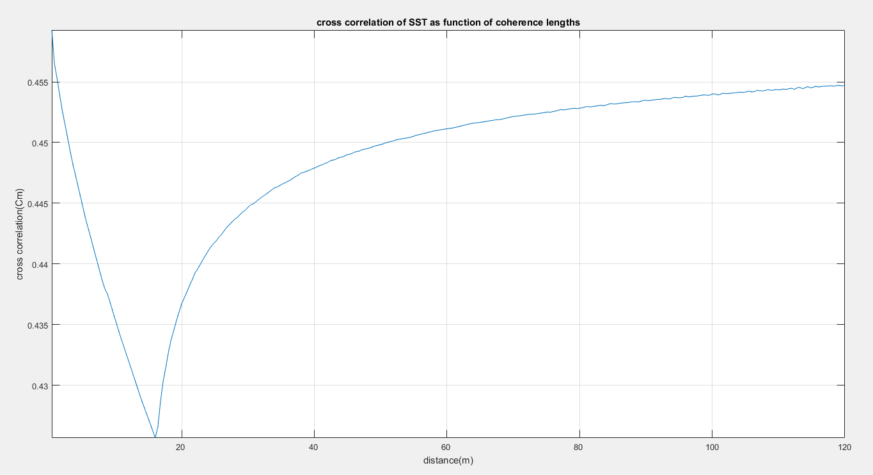
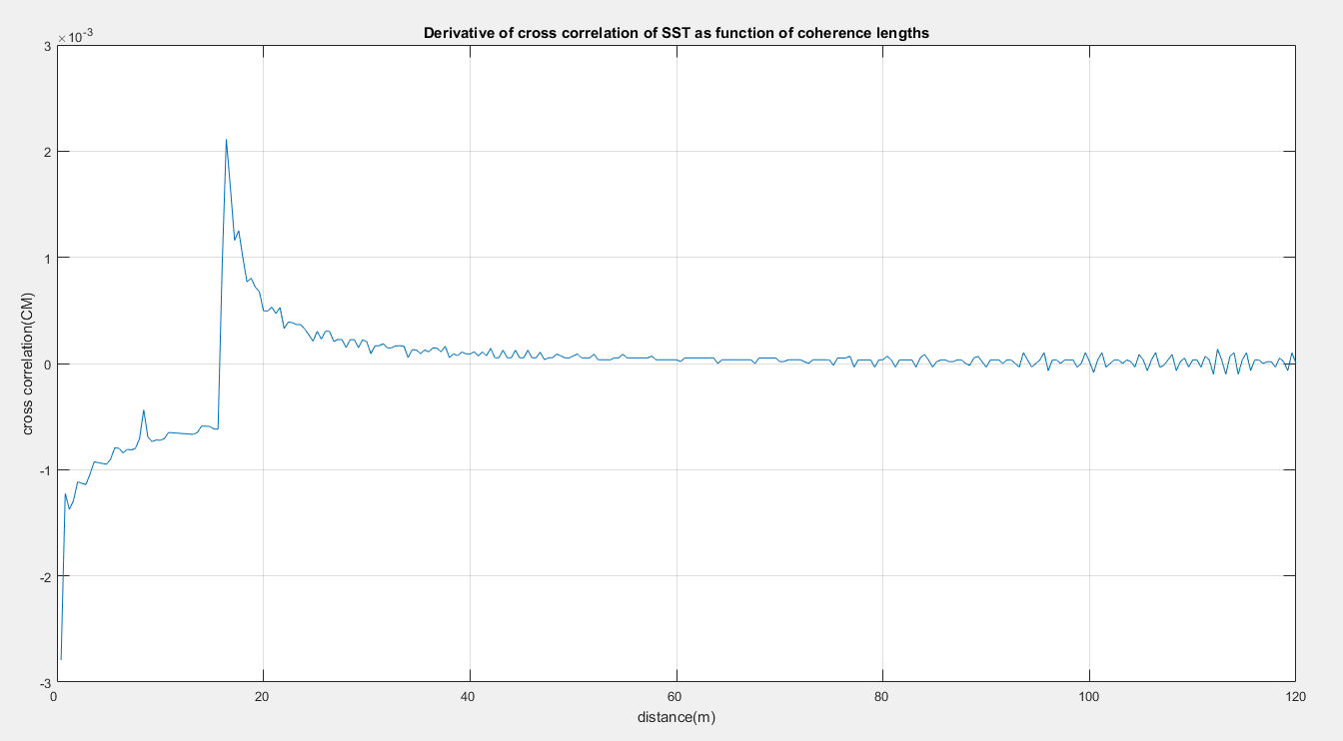
SST
we assume single stationary target at distance = 16.4 m
And correspondingly get a breakpoint 16.4 meters when cross correlation is displayed as function of range.
A spike is obtained at 16.4 m in derivative of corss correlation

Slide 13
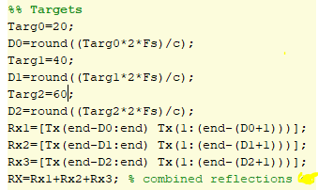
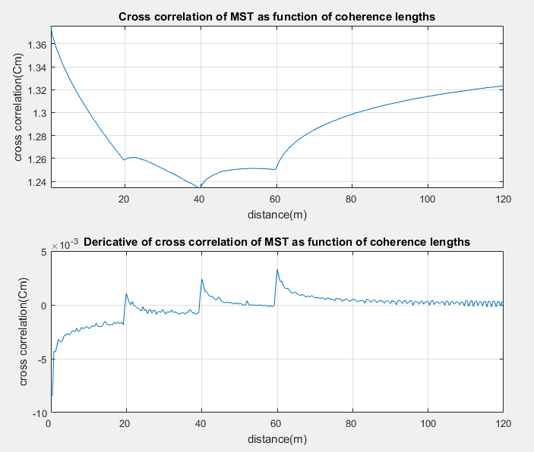
MST
Assuming 3 stationary targets at distances:
Target1=20m
Target2=40m
Target3=60m
We get 3 breakpoints at required distances and 3 spikes in derivative for these targets.

Slide 14
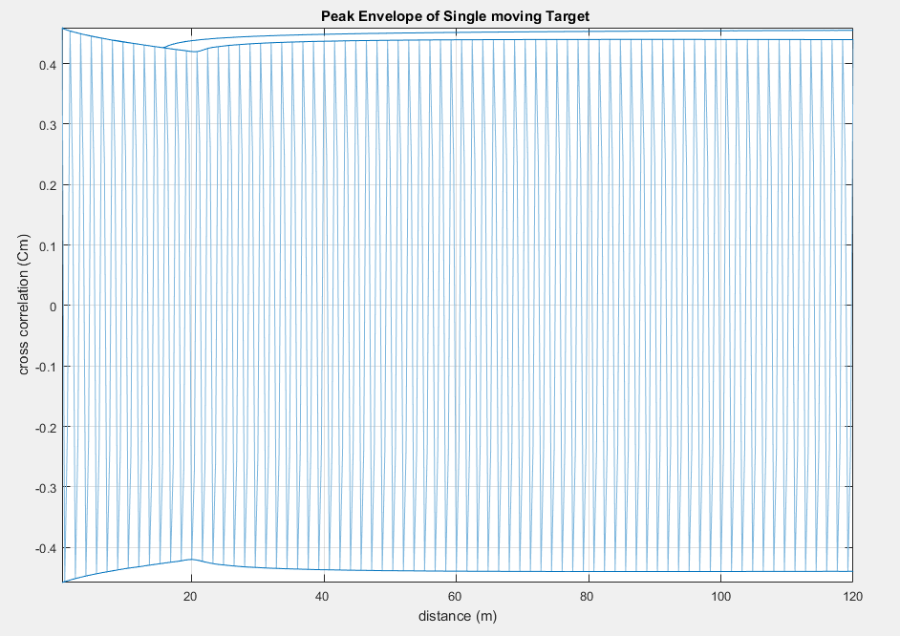
SMT (Single Moving Target)
As target moves, due phase accumulation there is oscillations in cross correlation instead of a smooth graph.
After doing envelope detection, it gets clear that moving targets have lesser slope than stationary target at same distances.
Displayed oscillations is the cross corrrelation of an accelerated target moving away and by outilining envelope, it is made visible that slope of moving targets is less than stationary one.
Where distance is 16 meters of stationary and moving target.
By increasing acceleration further, the slope decrease further more.

Slide 15
Conclusion
Range Resolution of Partially Coherent Radars is independant of Bandwidth.
Range Resolution of this radars increases by increasing M and N. Which in turn needs more computinng power.
It has no restriction on range.
Can even exploit dopper effect of moving targets.

Slide 16
Limitations
Requires High computing power for better range accuracy and range resolution.
Large Sweep time
Demands high-precision and fast switching phase jumps.

Slide 17


